Slide 1
BIBS
MRM Data Analysis
서다훈 & 최정인
Department of Statistics, Seoul National University

Slide 2
Research Goal
1. Development of protein marker panel for pancreatic cancer
2. More clinically relevant protein markers than CA19-9/TTR/LRG1 (Oncotarget 2017)
3. Higher prediction accuracy than selection model in AACR 2021
4. Development of new selection/prediction model for PDAC diagnosis
Notes:
현재 가지고 있는 데이터는 stage구분이 없다.
A total of 54 proteins, or 68 peptides, were validated in a large clinical sample [n=1008; 349 normal, 109 pancreatic benign diseases, 149 other cancer (thyroid, breast, and colorectal cancer), and 401 pancreatic cancer] by MRM analysis and ELISA [n=1002; 348 normal, 109 pancreatic benign diseases, 149 other cancer (thyroid, breast, and colorectal cancer), and 396 pancreatic cancer]. The multimarker panel was ultimately constructed by statistical analysis and supporting vector machine (SVM) method.
결국 Elisa data로 진행한듯?

Slide 3
Data Overview
Sample | Clinics | Total | Training | Test 1 | Test 2 | Test 3 | Test 4
Pancreatic cancer | Total | 399 | 319 | 80 | 80 | 80 | 25
 | AMC | 75 | 60 | 15 | 15 | 15 | 6
 | NCC | 128 | 102 | 26 | 26 | 26 | 6
 | SMC | 100 | 80 | 20 | 20 | 20 | 5
 | SNUH | 50 | 40 | 10 | 10 | 10 | 3
 | YMC | 46 | 37 | 9 | 9 | 9 | 5
Other cancer | SNUH | 149 | 0 | 0 | 149 | 0 | 0
Pancreatic benign disease | Total | 109 | 88 | 21 |  | 21 | 21
 | AMC | 47 | 38 | 9 |  | 9 | 9
 | SMC | 30 | 24 | 6 |  | 6 | 6
 | SNUH | 5 | 4 | 1 |  | 1 | 1
 | YMC | 27 | 22 | 5 |  | 5 | 5
Normal | SNUH | 349 | 279 | 70 |  | 0 | 70
Total |  | 1006 | 686 | 171 | 229 | 101 | 116
Test1: PDAC vs Control
Test2: PDAC vs Other Cancer
Test3: PDAC vs Pancreatic Benign
Test4: PDAC (low CA19-9 (< 37U/mL)) vs Control (Pancreatic Benign + Normal)
Notes:
현재 가지고 있는 데이터는 stage구분이 없다.
A total of 54 proteins, or 68 peptides, were validated in a large clinical sample [n=1008; 349 normal, 109 pancreatic benign diseases, 149 other cancer (thyroid, breast, and colorectal cancer), and 401 pancreatic cancer] by MRM analysis and ELISA [n=1002; 348 normal, 109 pancreatic benign diseases, 149 other cancer (thyroid, breast, and colorectal cancer), and 396 pancreatic cancer]. The multimarker panel was ultimately constructed by statistical analysis and supporting vector machine (SVM) method.
결국 Elisa data로 진행한듯?

Slide 4
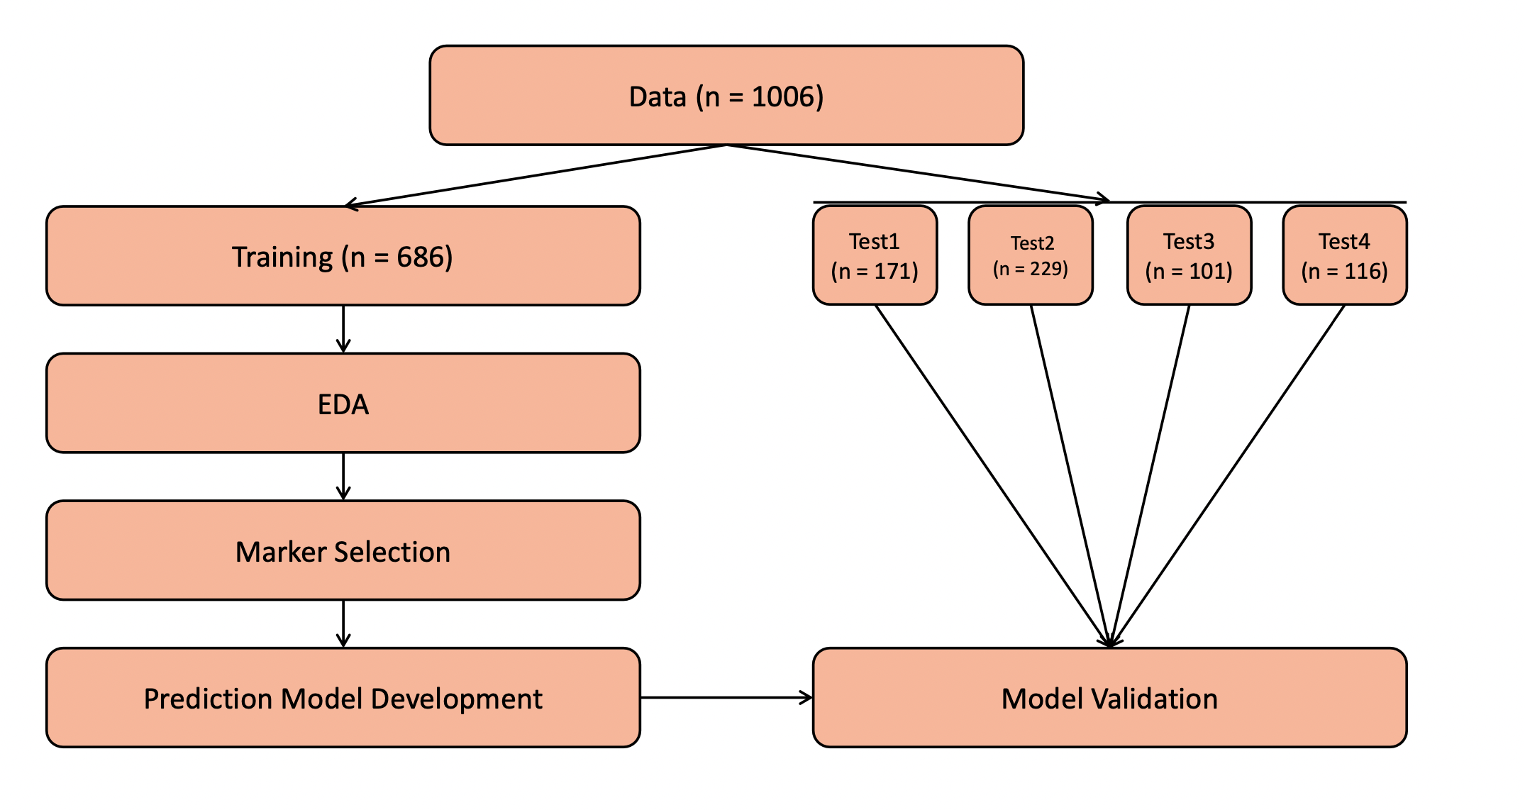
Analysis Overview
Notes:
현재 가지고 있는 데이터는 stage구분이 없다.
A total of 54 proteins, or 68 peptides, were validated in a large clinical sample [n=1008; 349 normal, 109 pancreatic benign diseases, 149 other cancer (thyroid, breast, and colorectal cancer), and 401 pancreatic cancer] by MRM analysis and ELISA [n=1002; 348 normal, 109 pancreatic benign diseases, 149 other cancer (thyroid, breast, and colorectal cancer), and 396 pancreatic cancer]. The multimarker panel was ultimately constructed by statistical analysis and supporting vector machine (SVM) method.
결국 Elisa data로 진행한듯?

Slide 5
Marker Overview
Peptide | Gene
GDIGETGVPGAEGPR | ADIPOQ
DPTFIPAPIQAK | AGT
QGIQFYTQLK | ALDH6A1
EFGNTLEDK | APOC1
EWFSETFQK | APOC1
VCPFAGILENGAVR | APOH
ILSGDPYCEK | BTD
LSSGLVTAALYGR | BTD
DYFIATCK | C1R
TNFDNDIALVR | C1S
TWYPEVPK | C4BPA
LSLEIEQLELQR | C4BPA
ALLAFQESK | C4BPB
NADYSYSVWK | C5
GGSASTWLTAFALR | C5
TLNICEVGTIR | C6
VLFYVDSEK | C7
EPAVLELEGK | CAP1
VLDVNDNAPK | CDH11
GEWVALNPLR | CFH
TGESVEFVCK | CFH
VFSLQWGEVK | CFI
TLLSNLEEAK | CLU
ASSIIDELFQDR | CLU
Peptide | Gene
IVVVTAGVR | LDHB
GLTSVINQK | LDHB
DLLLPQPDLR | LRG1
VAAGAFQGLR | LRG1
FQASVATPR | MBL2
ALAPEYAK | P4HB
GDSVSDSGSDALR | PDCD4
CDENILWLDYK | PKM2
NIQSLEVIGK | PPBP
ICLDPDAPR | PPBP
NNLELSTPLK | PROS1
DTEVLLVGLEPGTR | PTPRJ
CINQLLCK | SEPP1
GFQQLLQELNQPR | SERPINA5(IPSP)
VAEGTQVLELPFK | SERPINC1
IEDGFSLK | SERPINC1
FLEQECNVLPLK | SFTPB
VTGVVLFR | SOD3
NVLVTLYER | SPARC
GFLLLASLR | THBS1
TIVTTLQDSIR | THBS1
AADDTWEPFASGK | TTR
CMPTFQFFK | TXN
ILLAELEQLK | VIM
Peptide | Gene
GLPGEVLGAQPGPR | COL4A2
CDLISIPK | CORO1C
LSNNALSGLPQGVFGK | CPN2
VSTLPAITLK | CTSD
ELLALIQLER | ECM1
FAVLQENVAWGNGR | FCGBP
LSFQEFLK | FSTL1
ASCLYGQLPK | GSTP1
DGYLFQLLR | HRG
SPAYTLVWTR | HSPG2
LLGIETPLPK | ICAM1
VTLNGVPAQPLGPR | ICAM1
GLIDLTLDK | IFRD1
LIQGAPTIR | IGFBP2
ALAQCAPPPAVCAELVR | IGFBP3
YGQPLPGYTTK | IGFBP3
IQPSGGTNINEALLR | ITIH2
LALDNGGLAR | ITIH4
AGFSWIEVTFK | ITIH4
DSVTGTLPK | KLKB1
69 peptides (55 proteins)
14 proteins of 28 multiple peptides
(2 peptides per each protein)
Notes:
현재 가지고 있는 데이터는 stage구분이 없다.
A total of 54 proteins, or 68 peptides, were validated in a large clinical sample [n=1008; 349 normal, 109 pancreatic benign diseases, 149 other cancer (thyroid, breast, and colorectal cancer), and 401 pancreatic cancer] by MRM analysis and ELISA [n=1002; 348 normal, 109 pancreatic benign diseases, 149 other cancer (thyroid, breast, and colorectal cancer), and 396 pancreatic cancer]. The multimarker panel was ultimately constructed by statistical analysis and supporting vector machine (SVM) method.
결국 Elisa data로 진행한듯?

Slide 6
Marker Selection
“We will use only clinically meaningful markers among 69 peptides”
Commercialization with Elisa, not MRM
Then, Monoclonal Ab(MAb) for each protein marker needs to be considered
Upregulated protein marker is better for interpretation of cancer diagnosis
Notes:
현재 가지고 있는 데이터는 stage구분이 없다.
A total of 54 proteins, or 68 peptides, were validated in a large clinical sample [n=1008; 349 normal, 109 pancreatic benign diseases, 149 other cancer (thyroid, breast, and colorectal cancer), and 401 pancreatic cancer] by MRM analysis and ELISA [n=1002; 348 normal, 109 pancreatic benign diseases, 149 other cancer (thyroid, breast, and colorectal cancer), and 396 pancreatic cancer]. The multimarker panel was ultimately constructed by statistical analysis and supporting vector machine (SVM) method.
결국 Elisa data로 진행한듯?

Slide 7
Marker Selection
Clinically Relevant markers
Peptide | Gene
GDIGETGVPGAEGPR | ADIPOQ
DPTFIPAPIQAK | AGT
QGIQFYTQLK | ALDH6A1
EFGNTLEDK | APOC1
EWFSETFQK | APOC1
VCPFAGILENGAVR | APOH
ILSGDPYCEK | BTD
LSSGLVTAALYGR | BTD
DYFIATCK | C1R
TNFDNDIALVR | C1S
TWYPEVPK | C4BPA
LSLEIEQLELQR | C4BPA
ALLAFQESK | C4BPB
NADYSYSVWK | C5
GGSASTWLTAFALR | C5
TLNICEVGTIR | C6
VLFYVDSEK | C7
EPAVLELEGK | CAP1
VLDVNDNAPK | CDH11
GEWVALNPLR | CFH
TGESVEFVCK | CFH
VFSLQWGEVK | CFI
TLLSNLEEAK | CLU
ASSIIDELFQDR | CLU
Peptide | Gene
GLPGEVLGAQPGPR | COL4A2
CDLISIPK | CORO1C
LSNNALSGLPQGVFGK | CPN2
VSTLPAITLK | CTSD
ELLALIQLER | ECM1
FAVLQENVAWGNGR | FCGBP
LSFQEFLK | FSTL1
ASCLYGQLPK | GSTP1
DGYLFQLLR | HRG
SPAYTLVWTR | HSPG2
LLGIETPLPK | ICAM1
VTLNGVPAQPLGPR | ICAM1
GLIDLTLDK | IFRD1
LIQGAPTIR | IGFBP2
ALAQCAPPPAVCAELVR | IGFBP3
YGQPLPGYTTK | IGFBP3
IQPSGGTNINEALLR | ITIH2
LALDNGGLAR | ITIH4
AGFSWIEVTFK | ITIH4
DSVTGTLPK | KLKB1
IVVVTAGVR | LDHB
GLTSVINQK | LDHB
DLLLPQPDLR | LRG1
VAAGAFQGLR | LRG1
Peptide | Gene
FQASVATPR | MBL2
ALAPEYAK | P4HB
GDSVSDSGSDALR | PDCD4
CDENILWLDYK | PKM2
NIQSLEVIGK | PPBP
ICLDPDAPR | PPBP
NNLELSTPLK | PROS1
DTEVLLVGLEPGTR | PTPRJ
CINQLLCK | SEPP1
GFQQLLQELNQPR | SERPINA5(IPSP)
VAEGTQVLELPFK | SERPINC1
IEDGFSLK | SERPINC1
FLEQECNVLPLK | SFTPB
VTGVVLFR | SOD3
NVLVTLYER | SPARC
GFLLLASLR | THBS1
TIVTTLQDSIR | THBS1
AADDTWEPFASGK | TTR
CMPTFQFFK | TXN
ILLAELEQLK | VIM
Not MAb
(clinically irrelevant)
negatively correlated
positively correlated
Sign of Correlation was determined by single logistic regression
Notes:
심리학에서 나온 자극-반응의 이론을 토대로,

Slide 8
Marker Selection
Clinically Relevant markers
Peptide | Gene
GDIGETGVPGAEGPR | ADIPOQ
DPTFIPAPIQAK | AGT
ILSGDPYCEK | BTD
LSSGLVTAALYGR | BTD
DYFIATCK | C1R
TNFDNDIALVR | C1S
TWYPEVPK | C4BPA
LSLEIEQLELQR | C4BPA
ALLAFQESK | C4BPB
NADYSYSVWK | C5
GGSASTWLTAFALR | C5
TLNICEVGTIR | C6
VLFYVDSEK | C7
VLDVNDNAPK | CDH11
GEWVALNPLR | CFH
TGESVEFVCK | CFH
VFSLQWGEVK | CFI
Peptide | Gene
LSNNALSGLPQGVFGK | CPN2
VSTLPAITLK | CTSD
LSFQEFLK | FSTL1
SPAYTLVWTR | HSPG2
LLGIETPLPK | ICAM1
VTLNGVPAQPLGPR | ICAM1
GLIDLTLDK | IFRD1
LIQGAPTIR | IGFBP2
LALDNGGLAR | ITIH4
AGFSWIEVTFK | ITIH4
DLLLPQPDLR | LRG1
VAAGAFQGLR | LRG1
Peptide | Gene
FQASVATPR | MBL2
ALAPEYAK | P4HB
NIQSLEVIGK | PPBP
ICLDPDAPR | PPBP
NNLELSTPLK | PROS1
FLEQECNVLPLK | SFTPB
VTGVVLFR | SOD3
NVLVTLYER | SPARC
GFLLLASLR | THBS1
TIVTTLQDSIR | THBS1
CMPTFQFFK | TXN
ILLAELEQLK | VIM
Only clinically relevant markers were selected
(41 Peptides and 32 Proteins )
If there exists multiple peptides for single protein,
selected single peptide with larger simple marker prediction AUC
Notes:
심리학에서 나온 자극-반응의 이론을 토대로,

Slide 9
Model Selection
Marker Selection Model
Exhaustive Search
LASSO
Forward Selection
SHAP Value
( feature importance in DNN model )
Prediction Model
LR (Logistic Regression)
SVM (Support Vector Machine)
RF (Random Forest)
DNN (Deep Neural Network)
GAM (Generalized Additive Model)
MARS (Multivariate Adaptive Regression Spline Model)
Notes:
현재 가지고 있는 데이터는 stage구분이 없다.
A total of 54 proteins, or 68 peptides, were validated in a large clinical sample [n=1008; 349 normal, 109 pancreatic benign diseases, 149 other cancer (thyroid, breast, and colorectal cancer), and 401 pancreatic cancer] by MRM analysis and ELISA [n=1002; 348 normal, 109 pancreatic benign diseases, 149 other cancer (thyroid, breast, and colorectal cancer), and 396 pancreatic cancer]. The multimarker panel was ultimately constructed by statistical analysis and supporting vector machine (SVM) method.
결국 Elisa data로 진행한듯?

Slide 10
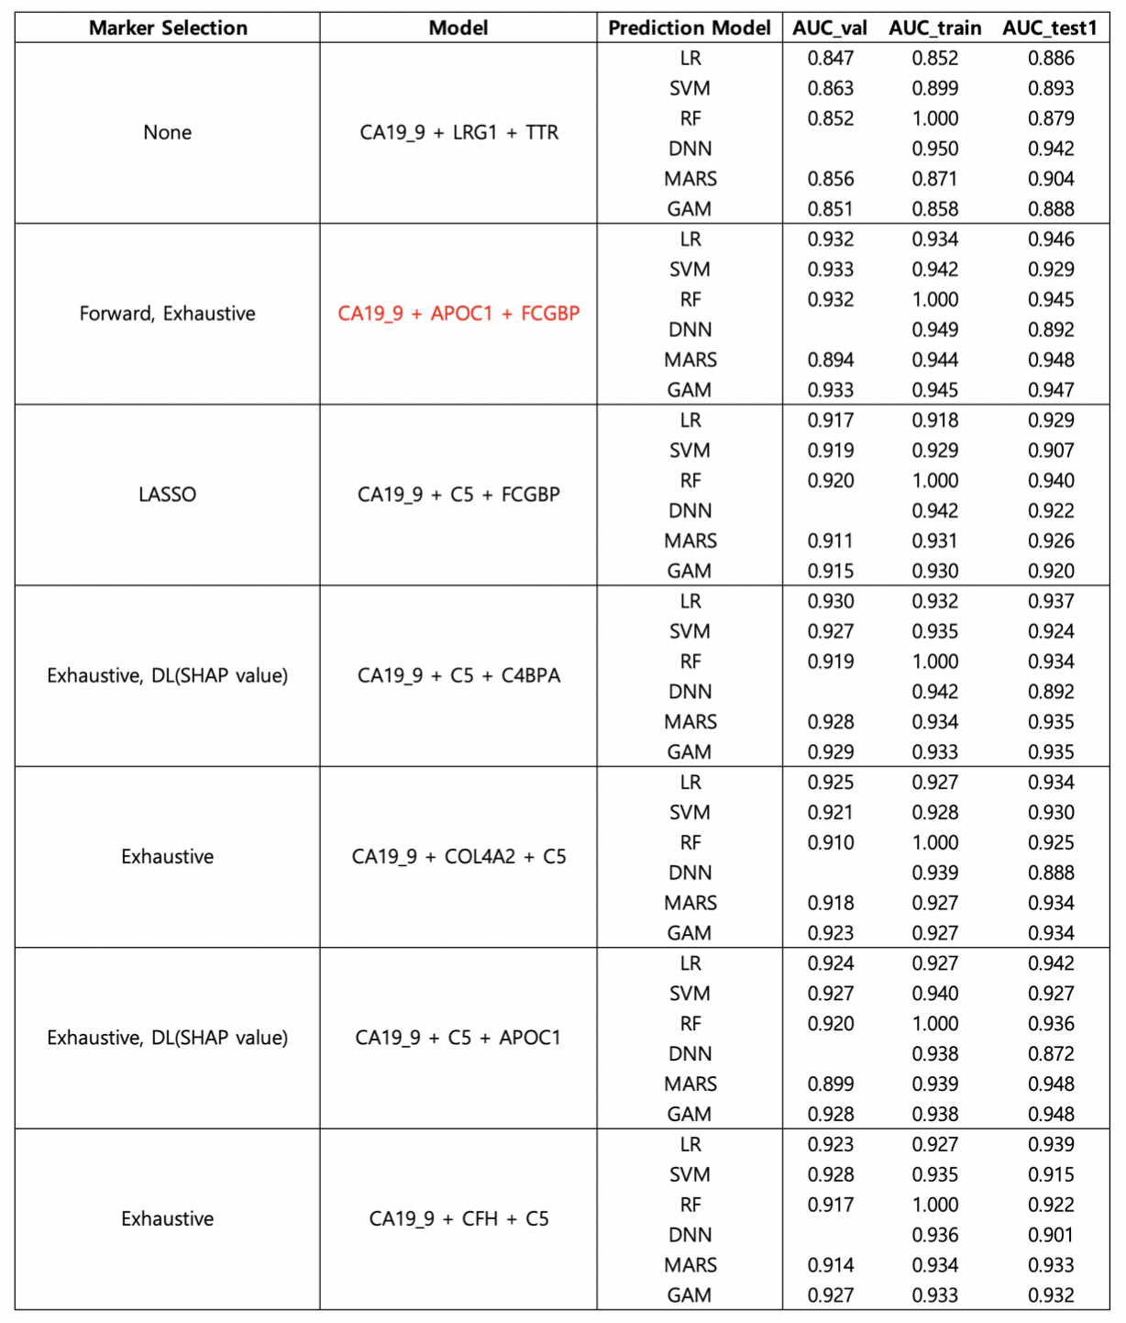
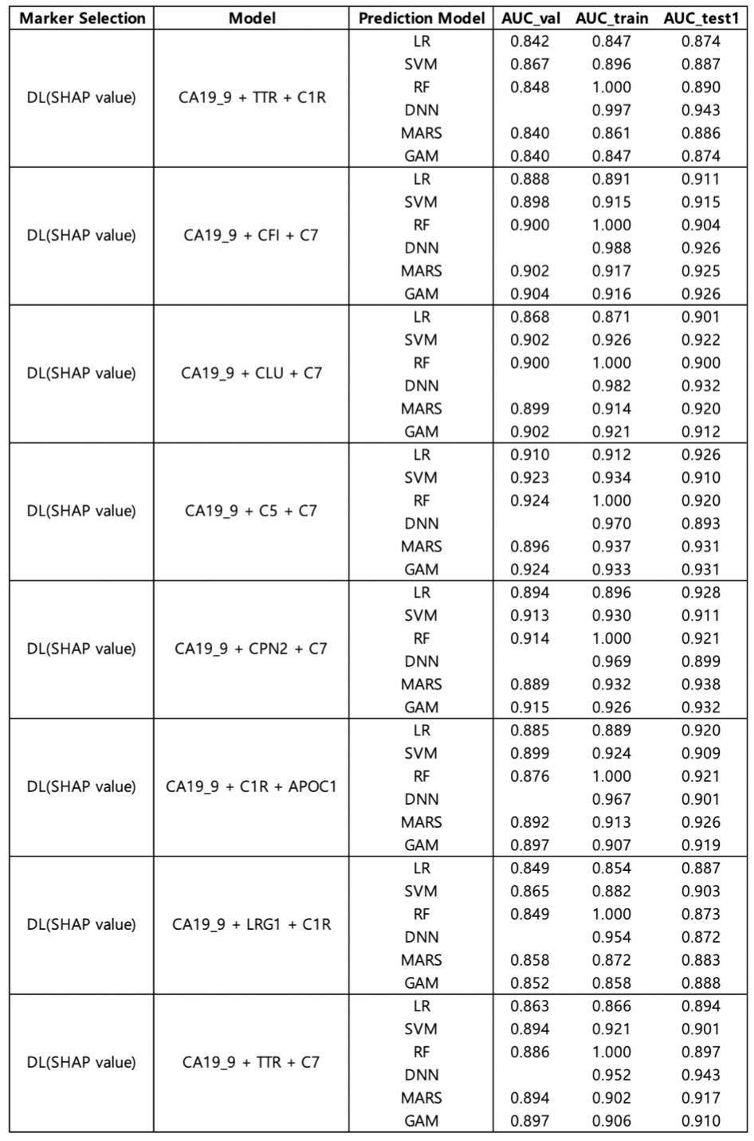
Result
Notes:
현재 가지고 있는 데이터는 stage구분이 없다.
A total of 54 proteins, or 68 peptides, were validated in a large clinical sample [n=1008; 349 normal, 109 pancreatic benign diseases, 149 other cancer (thyroid, breast, and colorectal cancer), and 401 pancreatic cancer] by MRM analysis and ELISA [n=1002; 348 normal, 109 pancreatic benign diseases, 149 other cancer (thyroid, breast, and colorectal cancer), and 396 pancreatic cancer]. The multimarker panel was ultimately constructed by statistical analysis and supporting vector machine (SVM) method.
결국 Elisa data로 진행한듯?

Slide 11
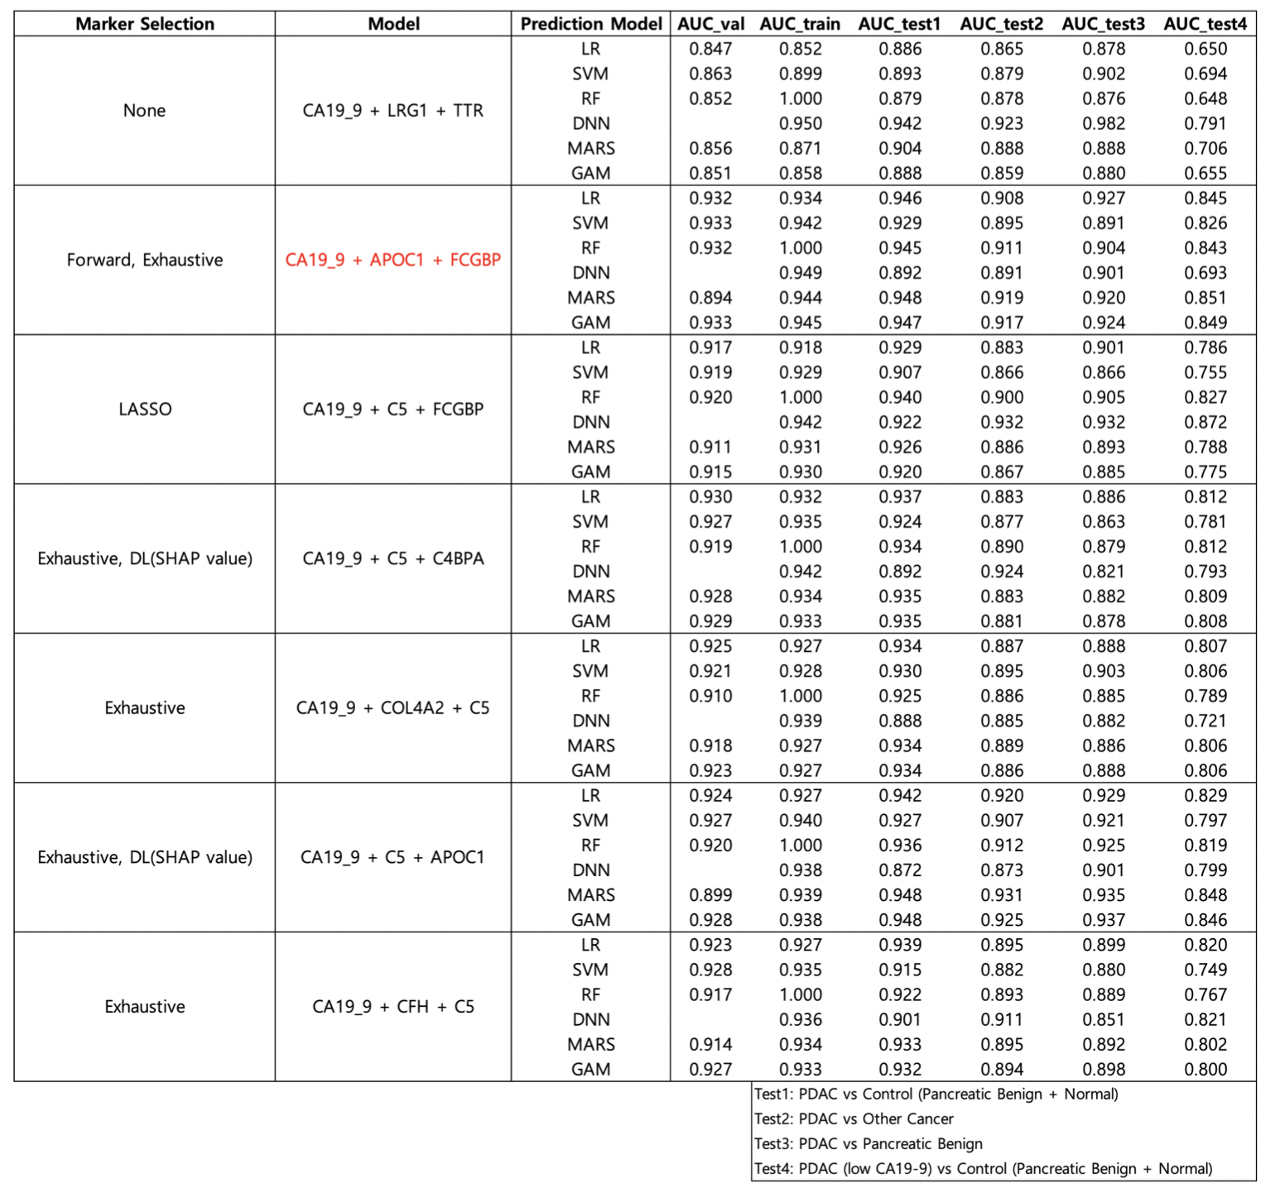
Result
Notes:
현재 가지고 있는 데이터는 stage구분이 없다.
A total of 54 proteins, or 68 peptides, were validated in a large clinical sample [n=1008; 349 normal, 109 pancreatic benign diseases, 149 other cancer (thyroid, breast, and colorectal cancer), and 401 pancreatic cancer] by MRM analysis and ELISA [n=1002; 348 normal, 109 pancreatic benign diseases, 149 other cancer (thyroid, breast, and colorectal cancer), and 396 pancreatic cancer]. The multimarker panel was ultimately constructed by statistical analysis and supporting vector machine (SVM) method.
결국 Elisa data로 진행한듯?

Slide 12
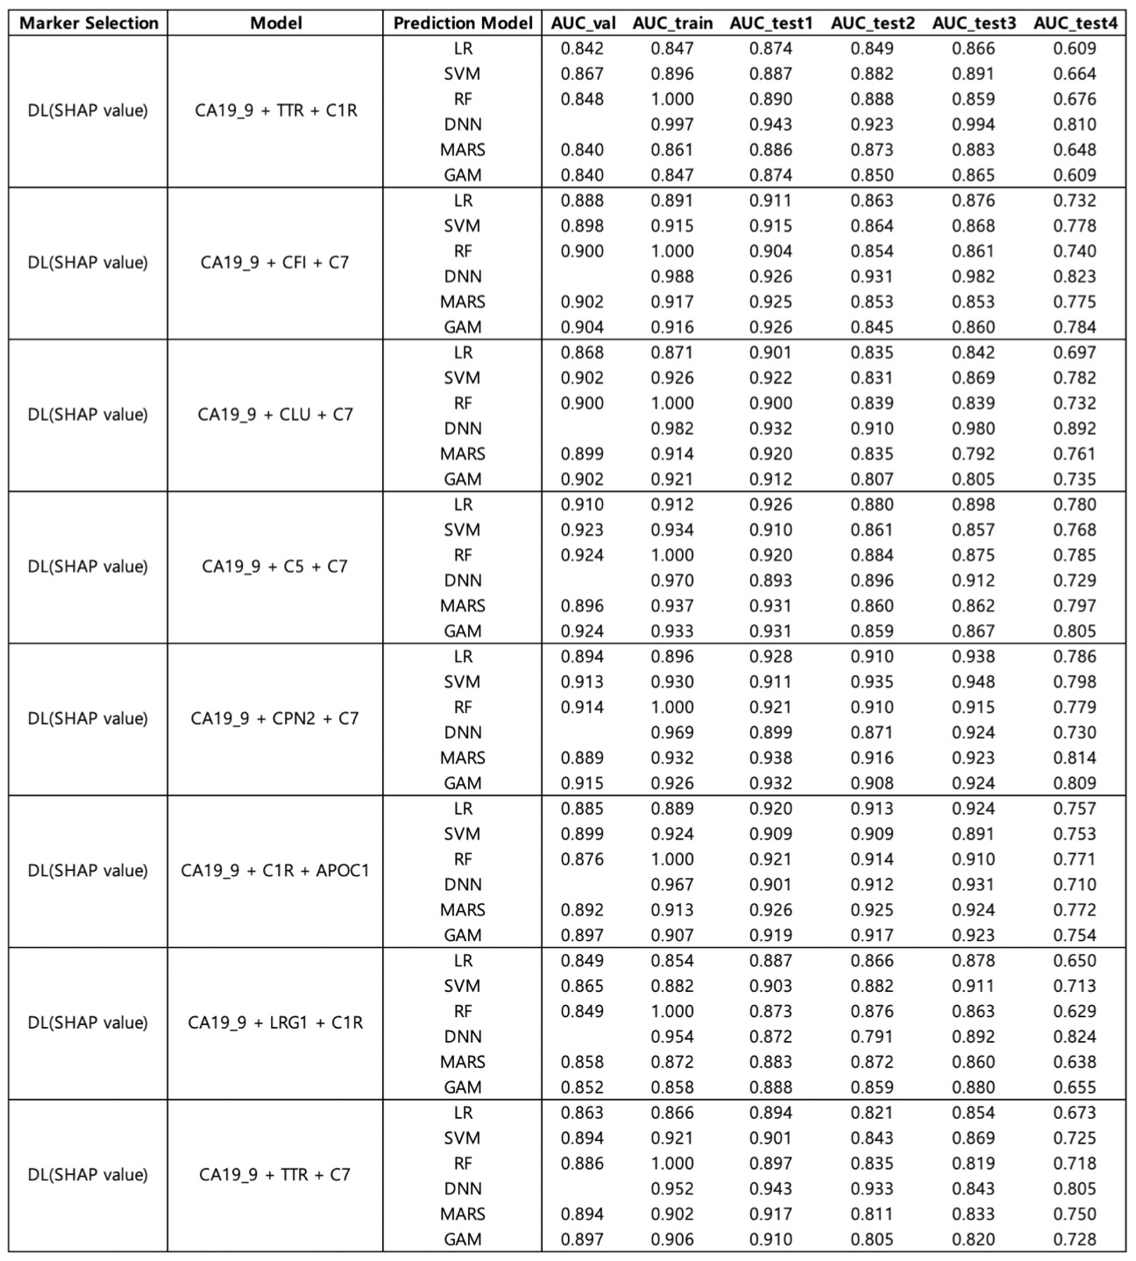
Notes:
현재 가지고 있는 데이터는 stage구분이 없다.
A total of 54 proteins, or 68 peptides, were validated in a large clinical sample [n=1008; 349 normal, 109 pancreatic benign diseases, 149 other cancer (thyroid, breast, and colorectal cancer), and 401 pancreatic cancer] by MRM analysis and ELISA [n=1002; 348 normal, 109 pancreatic benign diseases, 149 other cancer (thyroid, breast, and colorectal cancer), and 396 pancreatic cancer]. The multimarker panel was ultimately constructed by statistical analysis and supporting vector machine (SVM) method.
결국 Elisa data로 진행한듯?

Slide 13
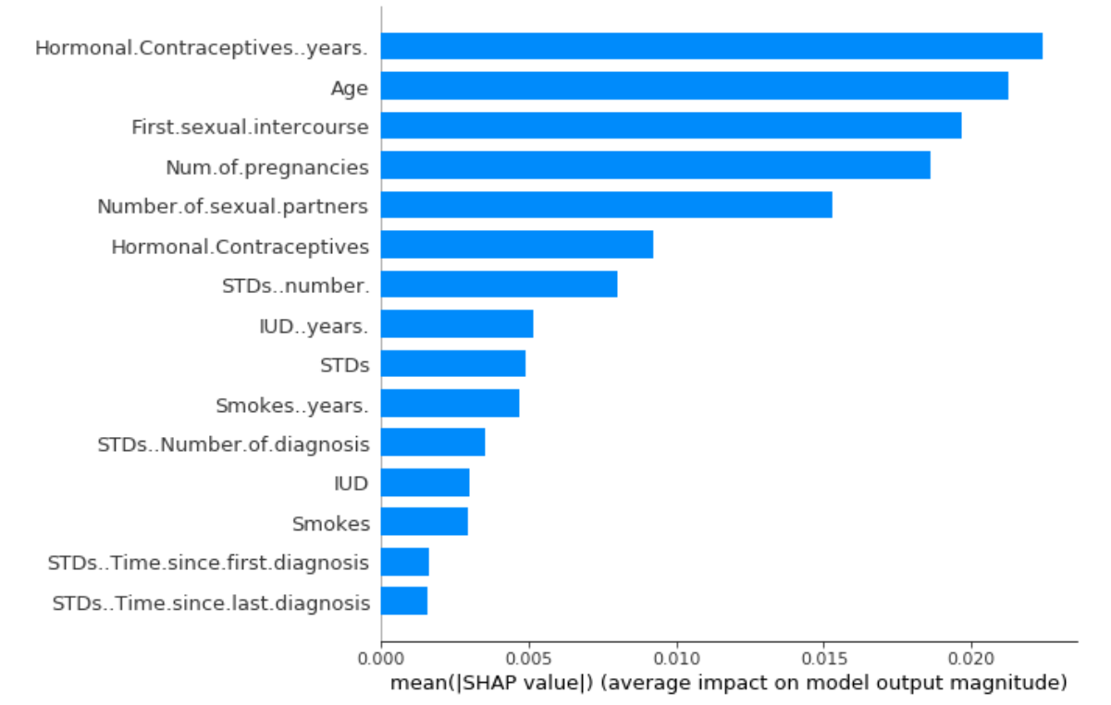
Result
Multi-marker model selected by Exhaustive Search / Stepwise / SHAP value
Number | Model | Prediction Model | All Positive Beta | AUC_train | AUC_val | AUC_test1 | AUC_test2 | AUC_test3 | AUC_test4
3 | CA19_9 + TTR + LRG1 | LR | FALSE | 0.919 | 0.916 | 0.934 | 0.878 | 0.889 | 0.804
 |  | SVM |  | 0.913 | 0.871 | 0.915 | 0.857 | 0.870 | 0.755
 |  | RF |  | 1.000 | 0.914 | 0.935 | 0.897 | 0.895 | 0.806
 |  | DNN |  | 0.932 | 0.929 | 0.931 | 0.941 | 0.910 | 0.791
 |  | MARS |  | 0.929 | 0.804 | 0.933 | 0.886 | 0.899 | 0.797
 |  | GAM |  | 0.922 | 0.915 | 0.932 | 0.876 | 0.886 | 0.797
3 | CA19_9 + IGFBP2 + HSPG2 | LR | TRUE | 0.928 | 0.927 | 0.942 | 0.917 | 0.936 | 0.830
 |  | SVM |  | 0.935 | 0.879 | 0.909 | 0.908 | 0.938 | 0.806
 |  | RF |  | 1.000 | 0.917 | 0.947 | 0.932 | 0.945 | 0.842
 |  | DNN |  | 0.972 | 0.936 | 0.910 | 0.927 | 0.952 | 0.834
 |  | MARS |  | 0.932 | 0.770 | 0.938 | 0.925 | 0.929 | 0.823
 |  | GAM |  | 0.937 | 0.921 | 0.941 | 0.930 | 0.941 | 0.836
4 | CA19_9 + IGFBP2 + HSPG2 + THBS1 | LR | TRUE | 0.932 | 0.930 | 0.943 | 0.908 | 0.931 | 0.836
 |  | SVM |  | 0.942 | 0.894 | 0.917 | 0.877 | 0.867 | 0.859
 |  | RF |  | 1.000 | 0.935 | 0.958 | 0.930 | 0.936 | 0.884
 |  | DNN |  | 0.980 | 0.937 | 0.932 | 0.925 | 0.942 | 0.845
 |  | MARS |  | 0.949 | 0.729 | 0.951 | 0.918 | 0.919 | 0.861
 |  | GAM |  | 0.956 | 0.930 | 0.945 | 0.905 | 0.923 | 0.855
 | CA19_9 + MBL2 + IGFBP2 + HSPG2 | LR | TRUE | 0.929 | 0.927 | 0.945 | 0.928 | 0.942 | 0.839
 |  | SVM |  | 0.925 | 0.871 | 0.914 | 0.906 | 0.922 | 0.825
 |  | RF |  | 1.000 | 0.922 | 0.946 | 0.930 | 0.947 | 0.840
 |  | DNN |  | 0.981 | 0.920 | 0.947 | 0.934 | 0.935 | 0.836
 |  | MARS |  | 0.932 | 0.777 | 0.938 | 0.925 | 0.929 | 0.823
 |  | GAM |  | 0.940 | 0.920 | 0.944 | 0.935 | 0.944 | 0.837
Notes:
심리학에서 나온 자극-반응의 이론을 토대로,

Slide 14
Result
5 | CA19_9 + MBL2 + IGFBP2 + HSPG2 + THBS1 | LR | TRUE | 0.933 | 0.931 | 0.948 | 0.916 | 0.931 | 0.848
 |  | SVM |  | 0.950 | 0.877 | 0.905 | 0.880 | 0.866 | 0.823
 |  | RF |  | 1.000 | 0.936 | 0.957 | 0.929 | 0.938 | 0.881
 |  | DNN |  | 0.986 | 0.931 | 0.930 | 0.902 | 0.945 | 0.889
 |  | MARS |  | 0.949 | 0.729 | 0.951 | 0.918 | 0.919 | 0.861
 |  | GAM |  | 0.959 | 0.929 | 0.944 | 0.909 | 0.926 | 0.853
 | CA19_9 + IFRD1 + IGFBP2 + HSPG2 + THBS1 | LR | TRUE | 0.933 | 0.931 | 0.941 | 0.911 | 0.934 | 0.831
 |  | SVM |  | 0.954 | 0.885 | 0.949 | 0.914 | 0.943 | 0.906
 |  | RF |  | 1.000 | 0.943 | 0.968 | 0.939 | 0.958 | 0.909
 |  | DNN |  | 0.990 | 0.940 | 0.928 | 0.941 | 0.953 | 0.890
 |  | MARS |  | 0.951 | 0.756 | 0.946 | 0.910 | 0.910 | 0.847
 |  | GAM |  | 0.957 | 0.936 | 0.946 | 0.896 | 0.910 | 0.847
6 | CA19_9 + MBL2 + IGFBP2 + HSPG2 + THBS1 + ICAM1 | LR | TRUE | 0.933 | 0.931 | 0.945 | 0.921 | 0.932 | 0.843
 |  | SVM |  | 0.938 | 0.883 | 0.921 | 0.893 | 0.889 | 0.849
 |  | RF |  | 1.000 | 0.939 | 0.954 | 0.930 | 0.926 | 0.876
 |  | DNN |  | 0.991 | 0.942 | 0.941 | 0.923 | 0.947 | 0.841
 |  | MARS |  | 0.949 | 0.719 | 0.951 | 0.918 | 0.919 | 0.861
 |  | GAM |  | 0.960 | 0.932 | 0.956 | 0.925 | 0.936 | 0.875
Notes:
심리학에서 나온 자극-반응의 이론을 토대로,

Slide 15
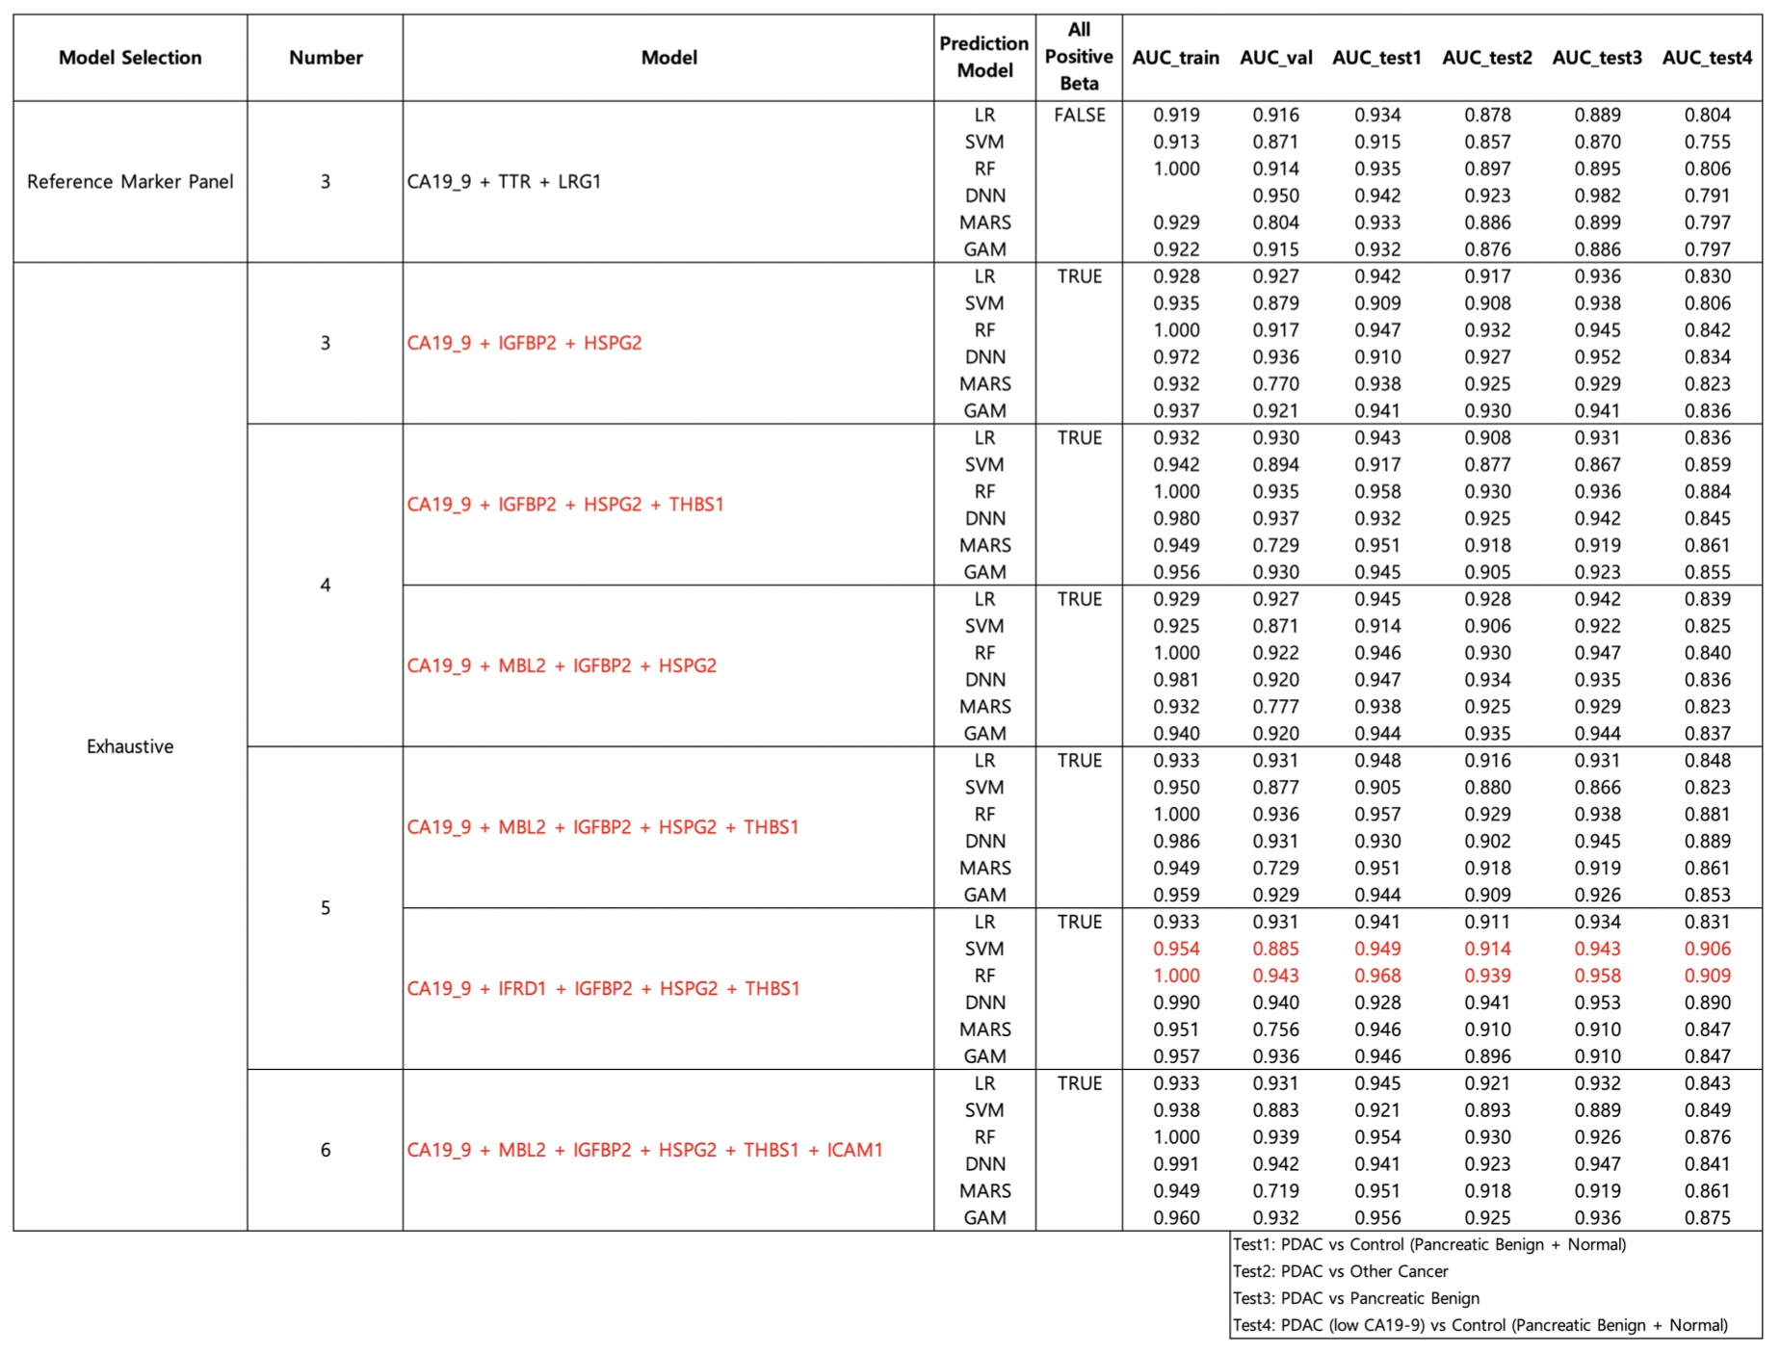

Result
Notes:
현재 가지고 있는 데이터는 stage구분이 없다.
A total of 54 proteins, or 68 peptides, were validated in a large clinical sample [n=1008; 349 normal, 109 pancreatic benign diseases, 149 other cancer (thyroid, breast, and colorectal cancer), and 401 pancreatic cancer] by MRM analysis and ELISA [n=1002; 348 normal, 109 pancreatic benign diseases, 149 other cancer (thyroid, breast, and colorectal cancer), and 396 pancreatic cancer]. The multimarker panel was ultimately constructed by statistical analysis and supporting vector machine (SVM) method.
결국 Elisa data로 진행한듯?

Slide 16
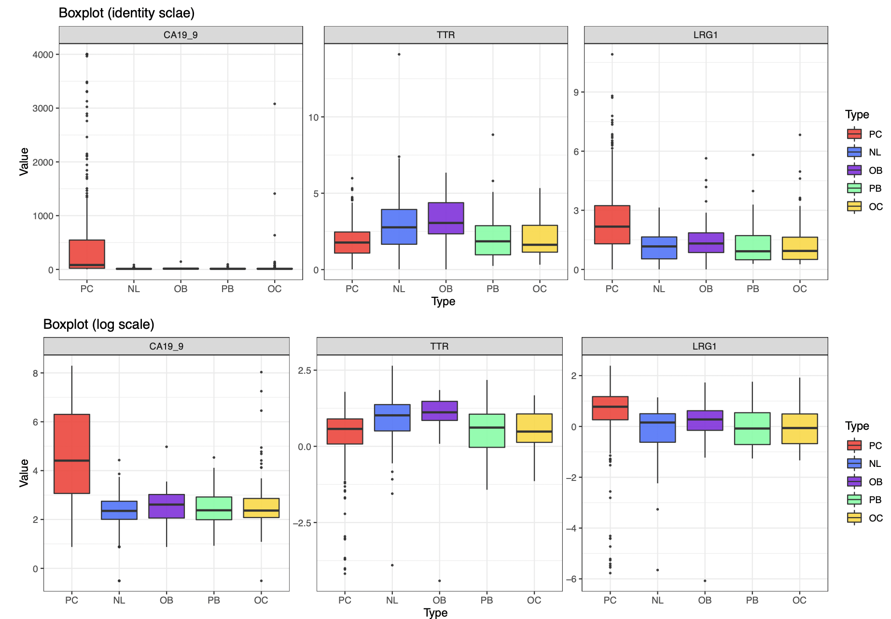
Model Performance
CA19-9 + TTR + LRG1
Notes:
현재 가지고 있는 데이터는 stage구분이 없다.
A total of 54 proteins, or 68 peptides, were validated in a large clinical sample [n=1008; 349 normal, 109 pancreatic benign diseases, 149 other cancer (thyroid, breast, and colorectal cancer), and 401 pancreatic cancer] by MRM analysis and ELISA [n=1002; 348 normal, 109 pancreatic benign diseases, 149 other cancer (thyroid, breast, and colorectal cancer), and 396 pancreatic cancer]. The multimarker panel was ultimately constructed by statistical analysis and supporting vector machine (SVM) method.
결국 Elisa data로 진행한듯?

Slide 17
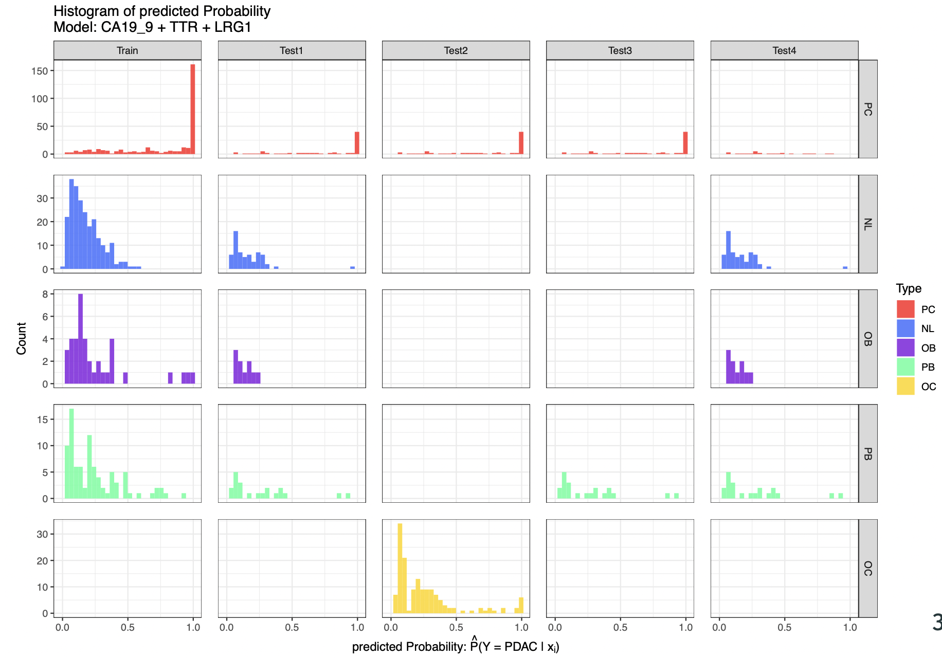
Model Performance
CA19-9 + TTR + LRG1
Test1: PDAC vs Control Test2: PDAC vs Other Cancer Test3: PDAC vs Pancreatic Benign Test4: PDAC(low CA19-9) vs Control
Notes:
현재 가지고 있는 데이터는 stage구분이 없다.
A total of 54 proteins, or 68 peptides, were validated in a large clinical sample [n=1008; 349 normal, 109 pancreatic benign diseases, 149 other cancer (thyroid, breast, and colorectal cancer), and 401 pancreatic cancer] by MRM analysis and ELISA [n=1002; 348 normal, 109 pancreatic benign diseases, 149 other cancer (thyroid, breast, and colorectal cancer), and 396 pancreatic cancer]. The multimarker panel was ultimately constructed by statistical analysis and supporting vector machine (SVM) method.
결국 Elisa data로 진행한듯?

Slide 18
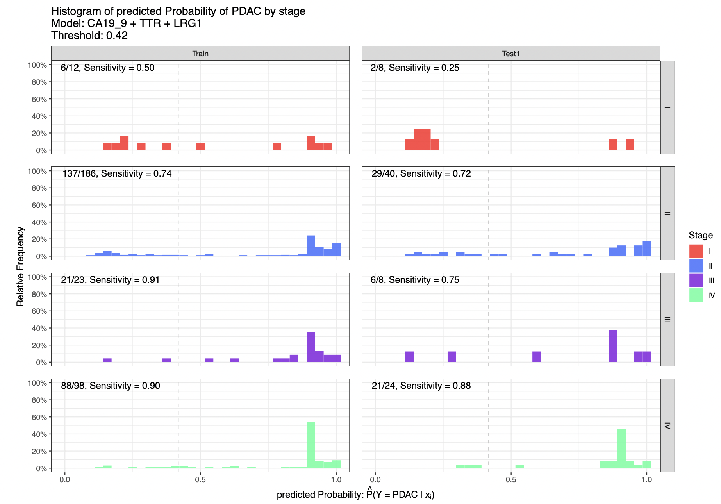
Model Performance
CA19-9 + TTR + LRG1
Notes:
현재 가지고 있는 데이터는 stage구분이 없다.
A total of 54 proteins, or 68 peptides, were validated in a large clinical sample [n=1008; 349 normal, 109 pancreatic benign diseases, 149 other cancer (thyroid, breast, and colorectal cancer), and 401 pancreatic cancer] by MRM analysis and ELISA [n=1002; 348 normal, 109 pancreatic benign diseases, 149 other cancer (thyroid, breast, and colorectal cancer), and 396 pancreatic cancer]. The multimarker panel was ultimately constructed by statistical analysis and supporting vector machine (SVM) method.
결국 Elisa data로 진행한듯?

Slide 19
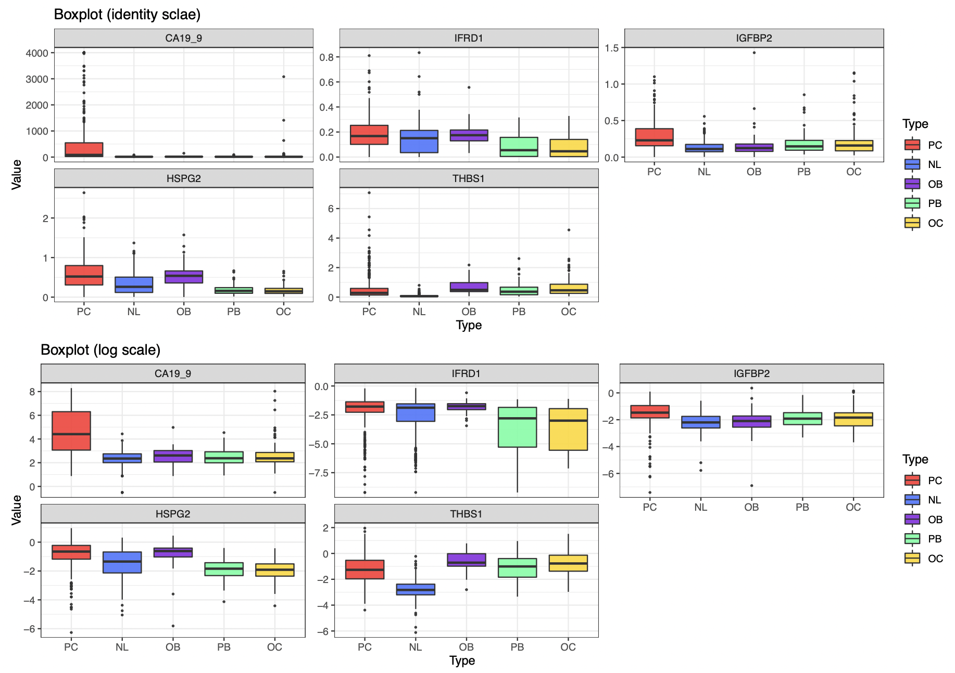
Model Performance
CA19-9 + IFRD1 + IGFBP2 + HSPG2 + THBS1
Notes:
현재 가지고 있는 데이터는 stage구분이 없다.
A total of 54 proteins, or 68 peptides, were validated in a large clinical sample [n=1008; 349 normal, 109 pancreatic benign diseases, 149 other cancer (thyroid, breast, and colorectal cancer), and 401 pancreatic cancer] by MRM analysis and ELISA [n=1002; 348 normal, 109 pancreatic benign diseases, 149 other cancer (thyroid, breast, and colorectal cancer), and 396 pancreatic cancer]. The multimarker panel was ultimately constructed by statistical analysis and supporting vector machine (SVM) method.
결국 Elisa data로 진행한듯?

Slide 20
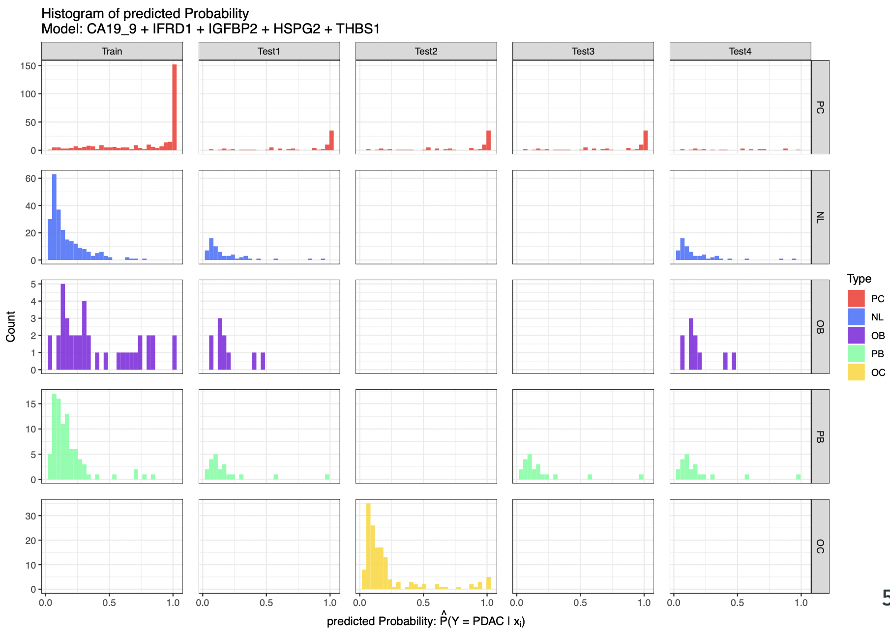
Model Performance
CA19-9 + IFRD1 + IGFBP2 + HSPG2 + THBS1
Test1: PDAC vs Control Test2: PDAC vs Other Cancer Test3: PDAC vs Pancreatic Benign Test4: PDAC(low CA19-9) vs Control
Notes:
현재 가지고 있는 데이터는 stage구분이 없다.
A total of 54 proteins, or 68 peptides, were validated in a large clinical sample [n=1008; 349 normal, 109 pancreatic benign diseases, 149 other cancer (thyroid, breast, and colorectal cancer), and 401 pancreatic cancer] by MRM analysis and ELISA [n=1002; 348 normal, 109 pancreatic benign diseases, 149 other cancer (thyroid, breast, and colorectal cancer), and 396 pancreatic cancer]. The multimarker panel was ultimately constructed by statistical analysis and supporting vector machine (SVM) method.
결국 Elisa data로 진행한듯?

Slide 21
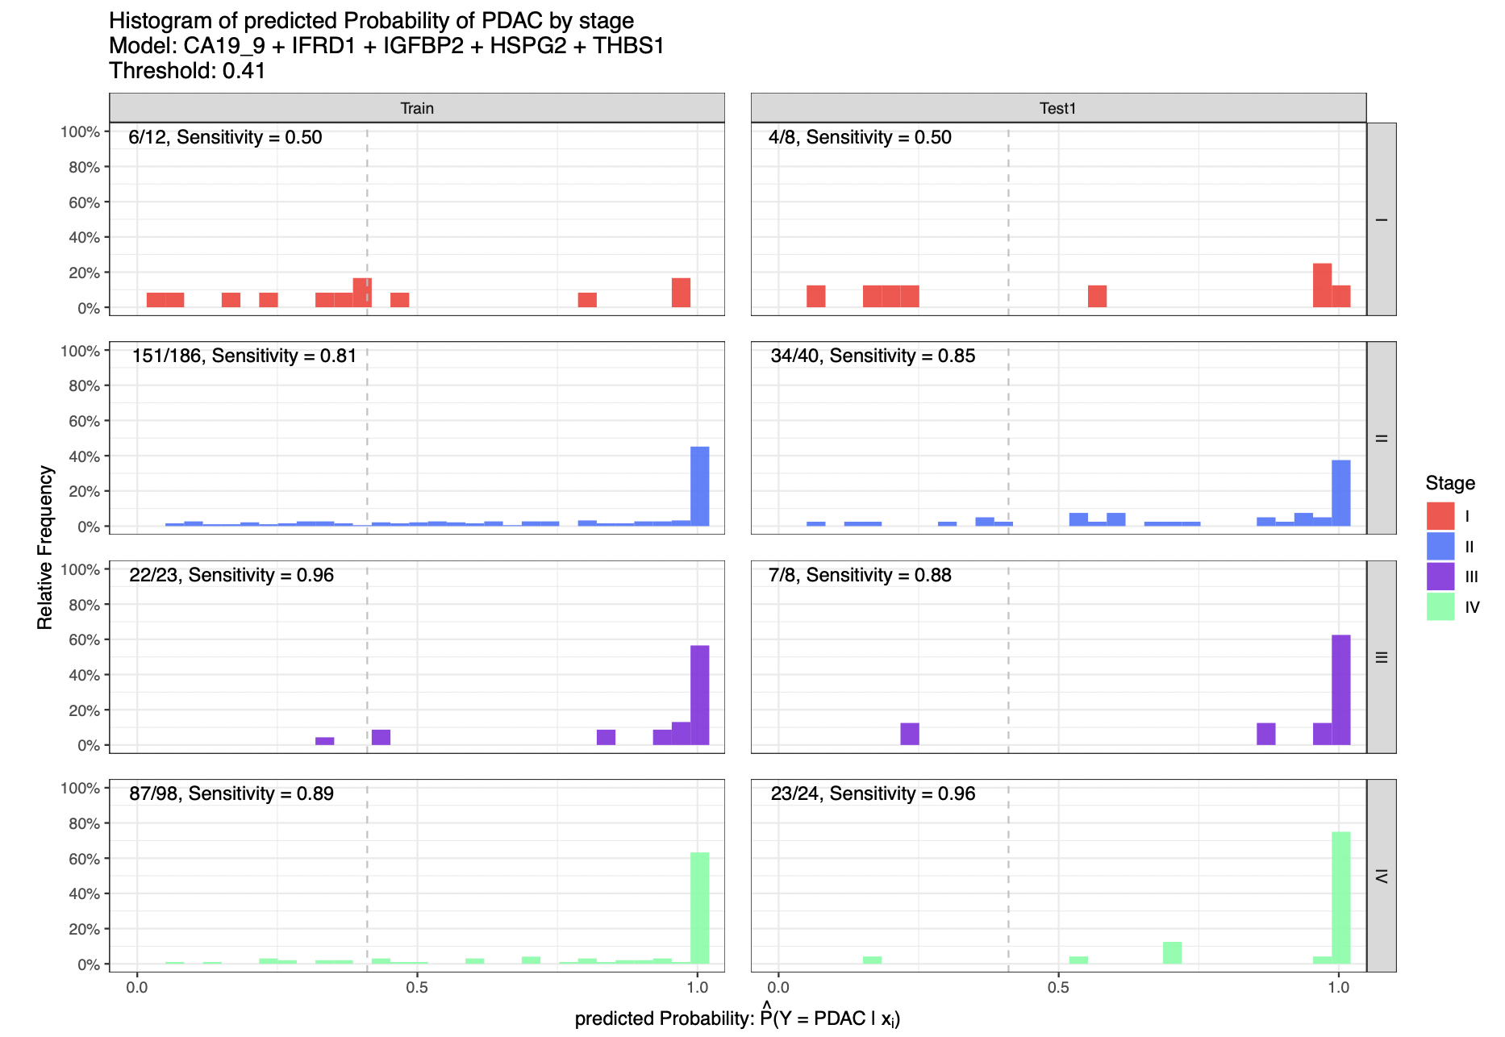
Model Performance
CA19-9 + IFRD1 + IGFBP2 + HSPG2 + THBS1
Notes:
현재 가지고 있는 데이터는 stage구분이 없다.
A total of 54 proteins, or 68 peptides, were validated in a large clinical sample [n=1008; 349 normal, 109 pancreatic benign diseases, 149 other cancer (thyroid, breast, and colorectal cancer), and 401 pancreatic cancer] by MRM analysis and ELISA [n=1002; 348 normal, 109 pancreatic benign diseases, 149 other cancer (thyroid, breast, and colorectal cancer), and 396 pancreatic cancer]. The multimarker panel was ultimately constructed by statistical analysis and supporting vector machine (SVM) method.
결국 Elisa data로 진행한듯?

Slide 22
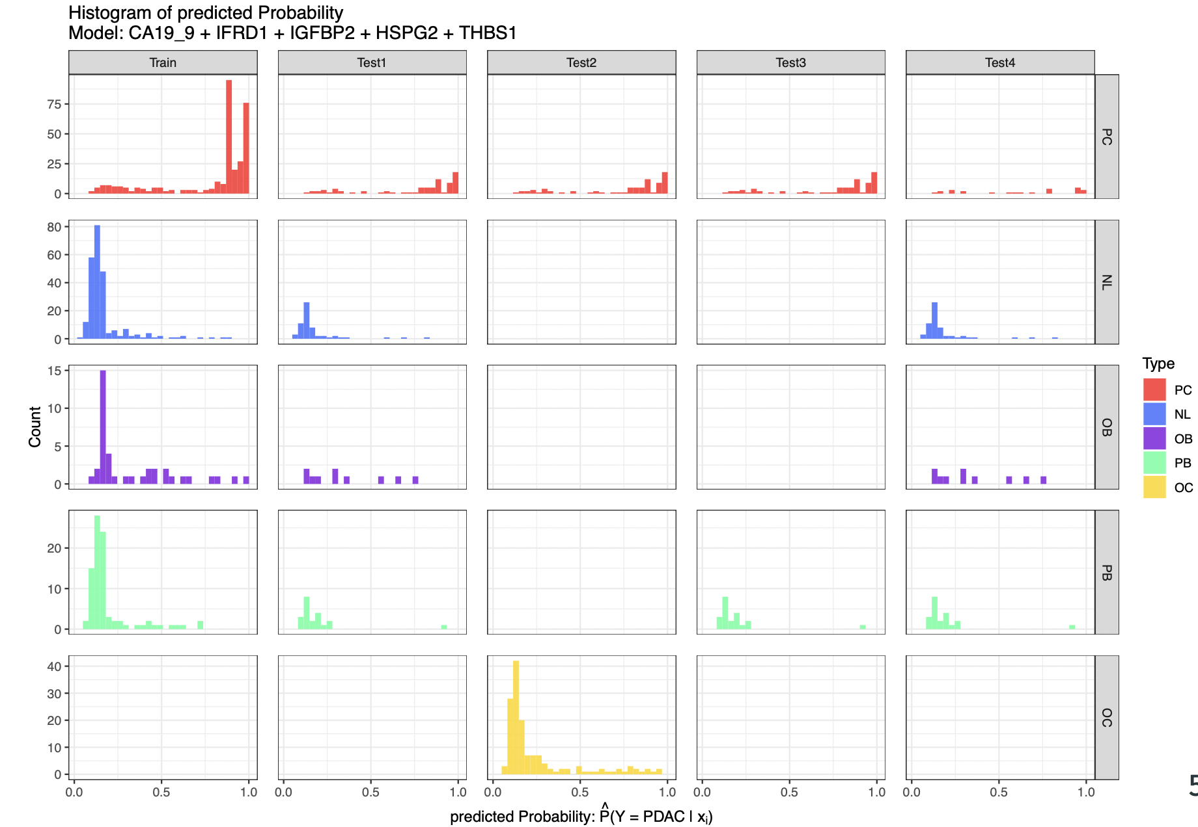
Model Performance
CA19-9 + IFRD1 + IGFBP2 + HSPG2 + THBS1 (SVM)
Test1: PDAC vs Control Test2: PDAC vs Other Cancer Test3: PDAC vs Pancreatic Benign Test4: PDAC(low CA19-9) vs Control
Notes:
현재 가지고 있는 데이터는 stage구분이 없다.
A total of 54 proteins, or 68 peptides, were validated in a large clinical sample [n=1008; 349 normal, 109 pancreatic benign diseases, 149 other cancer (thyroid, breast, and colorectal cancer), and 401 pancreatic cancer] by MRM analysis and ELISA [n=1002; 348 normal, 109 pancreatic benign diseases, 149 other cancer (thyroid, breast, and colorectal cancer), and 396 pancreatic cancer]. The multimarker panel was ultimately constructed by statistical analysis and supporting vector machine (SVM) method.
결국 Elisa data로 진행한듯?

Slide 23
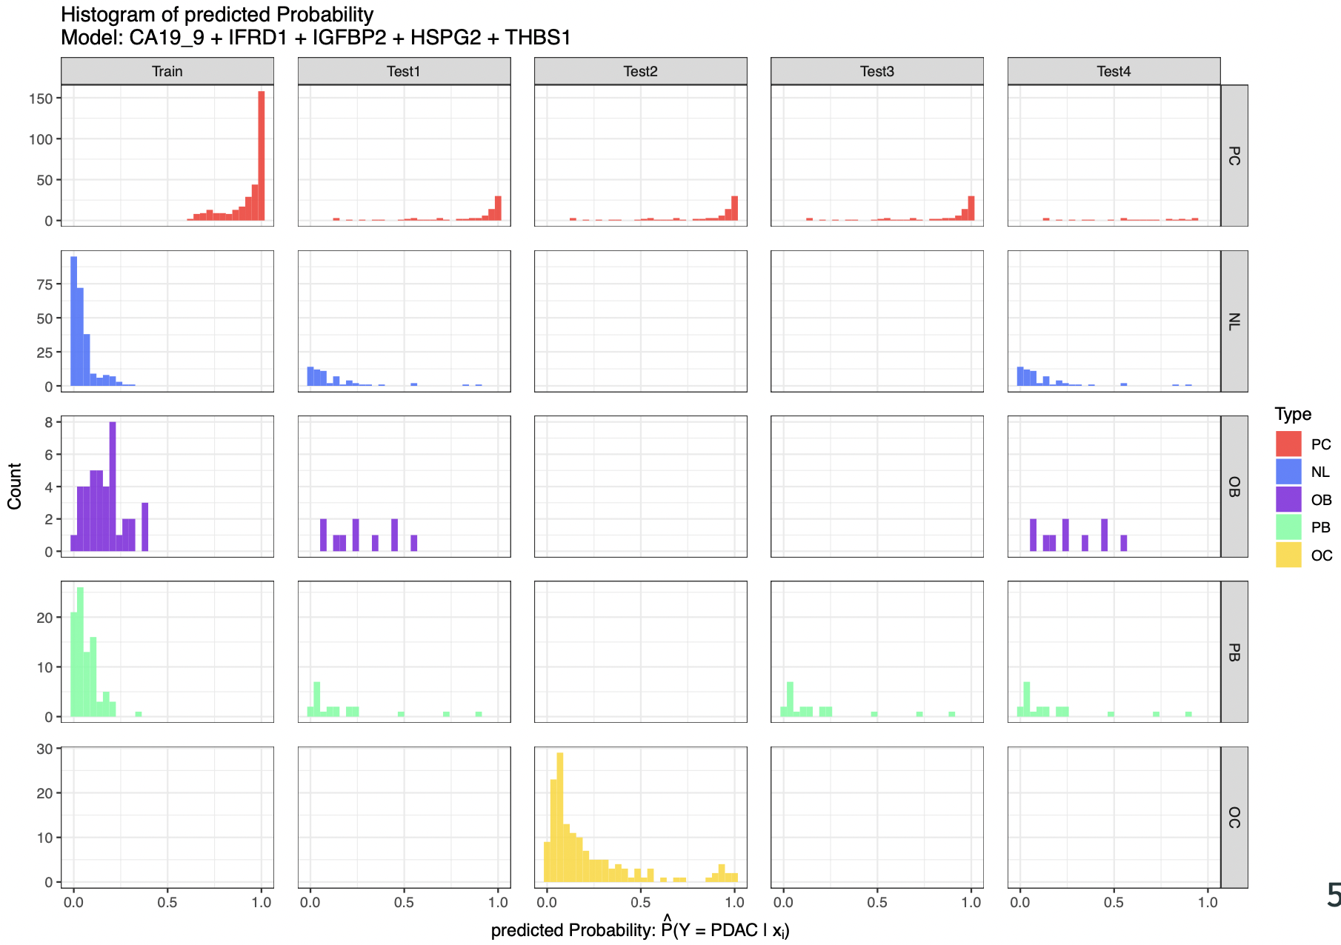
Model Performance
CA19-9 + IFRD1 + IGFBP2 + HSPG2 + THBS1 (RF)
Test1: PDAC vs Control Test2: PDAC vs Other Cancer Test3: PDAC vs Pancreatic Benign Test4: PDAC(low CA19-9) vs Control
Notes:
현재 가지고 있는 데이터는 stage구분이 없다.
A total of 54 proteins, or 68 peptides, were validated in a large clinical sample [n=1008; 349 normal, 109 pancreatic benign diseases, 149 other cancer (thyroid, breast, and colorectal cancer), and 401 pancreatic cancer] by MRM analysis and ELISA [n=1002; 348 normal, 109 pancreatic benign diseases, 149 other cancer (thyroid, breast, and colorectal cancer), and 396 pancreatic cancer]. The multimarker panel was ultimately constructed by statistical analysis and supporting vector machine (SVM) method.
결국 Elisa data로 진행한듯?

Slide 24
Discussion
CA19-9 + TTR + LRG1 => CA19-9 + IFRD1 + IGFBP2 + HSPG2 + THBS1
Enhancement of AUC in every test set (1~4)
New marker selection model (Stepwise => DNN + Stepwise )
New prediction model (Logistic Regression => SVM, RF)
But, in predicted probability histogram, our model could not distinguish PDAC vs Control
=> Enhancement of performance on samples with low CA19-9
Notes:
현재 가지고 있는 데이터는 stage구분이 없다.
A total of 54 proteins, or 68 peptides, were validated in a large clinical sample [n=1008; 349 normal, 109 pancreatic benign diseases, 149 other cancer (thyroid, breast, and colorectal cancer), and 401 pancreatic cancer] by MRM analysis and ELISA [n=1002; 348 normal, 109 pancreatic benign diseases, 149 other cancer (thyroid, breast, and colorectal cancer), and 396 pancreatic cancer]. The multimarker panel was ultimately constructed by statistical analysis and supporting vector machine (SVM) method.
결국 Elisa data로 진행한듯?

Slide 25
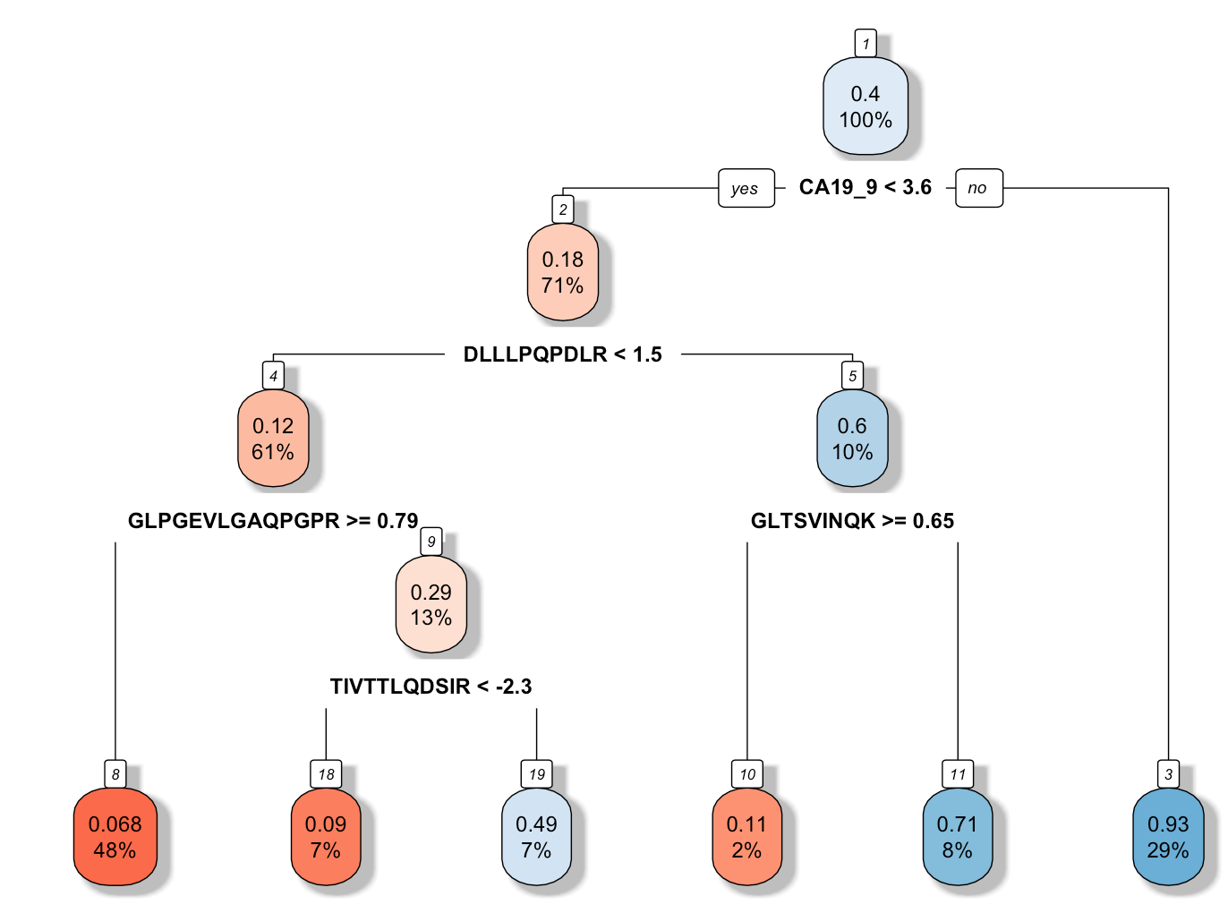
Low CA19-9 analysis
Univariate split tree model
Each node shows - the predicted value - the percentage of observations in the node
PDAC vs others
Notes:
심리학에서 나온 자극-반응의 이론을 토대로,

Slide 26
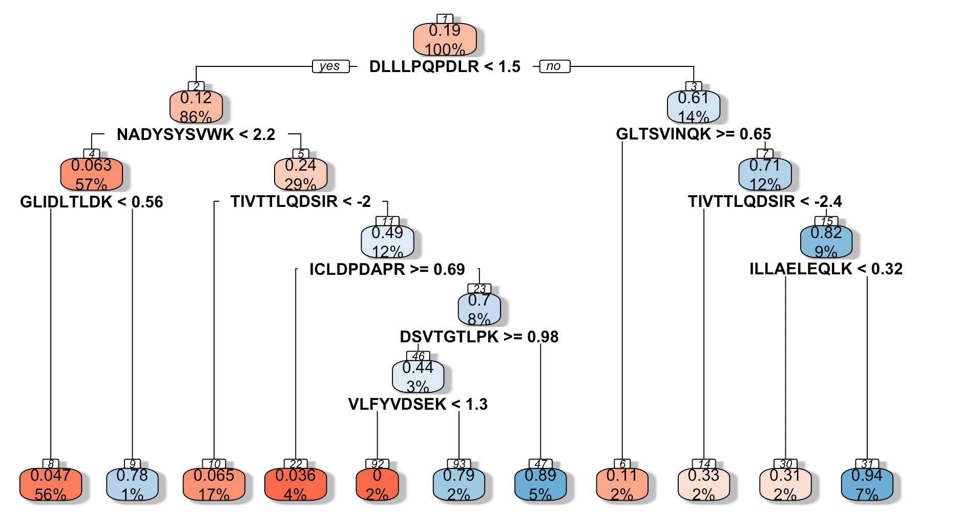


Low CA19-9 analysis
Univariate split tree model for samples with low CA19-9 (n=119)
LRG1
THBS1
IGFBP2
C5
IFRD1
ITIH4
ICAM1
MBL2
C7
CFI
PDAC (CA19-9 < 37) vs others
Notes:
심리학에서 나온 자극-반응의 이론을 토대로,

Slide 27
Low CA19-9 analysis
Model | Prediction Model | AUC_train | AUC_val | AUC_test1 | AUC_test2 | AUC_test3 | AUC_test4
CA19_9 + IFRD1 + IGFBP2 + HSPG2 + THBS1 (Previously Selected Model) | LR | 0.933 | 0.931 | 0.941 | 0.911 | 0.934 | 0.831
 | SVM | 0.954 | 0.885 | 0.949 | 0.914 | 0.943 | 0.906
 | RF | 1.000 | 0.943 | 0.968 | 0.939 | 0.958 | 0.909
 | DNN | 0.990 | 0.940 | 0.928 | 0.941 | 0.953 | 0.890
 | MARS | 0.951 | 0.756 | 0.946 | 0.910 | 0.910 | 0.847
 | GAM | 0.957 | 0.936 | 0.946 | 0.896 | 0.910 | 0.847
LRG1 + C5 + IGFBP2 + HSPG2 + THBS1 (Markers for low CA19-9 samples) | LR | 0.793 | 0.831 | 0.648 | 0.816 | 0.731 | 0.823
 | SVM | 0.810 | 0.707 | 0.605 | 0.780 | 0.766 | 0.907
 | RF | 0.749 | 0.730 | 0.757 | 0.729 | 0.738 | 0.902
 | DNN | 0.886 | 0.731 | 0.730 | 0.702 | 0.845 | 0.907
 | MARS | 0.749 | 0.729 | 0.751 | 0.818 | 0.819 | 0.821
 | GAM | 0.759 | 0.829 | 0.844 | 0.799 | 0.826 | 0.853
CA19-9 + LRG1 + C5 + IGFBP2 + HSPG2 + THBS1 (CA19-9 + Markers for low CA19-9 samples) | LR | 0.933 | 0.931 | 0.945 | 0.921 | 0.932 | 0.818
 | SVM | 0.938 | 0.883 | 0.921 | 0.893 | 0.889 | 0.907
 | RF | 1.000 | 0.939 | 0.954 | 0.930 | 0.926 | 0.903
 | DNN | 0.991 | 0.942 | 0.941 | 0.923 | 0.947 | 0.909
 | MARS | 0.949 | 0.719 | 0.951 | 0.918 | 0.919 | 0.861
 | GAM | 0.960 | 0.932 | 0.956 | 0.925 | 0.936 | 0.875
Notes:
심리학에서 나온 자극-반응의 이론을 토대로,

Slide 28
Discussion
Model | Prediction Model | AUC_train | AUC_val | AUC_test1 | AUC_test2 | AUC_test3 | AUC_test4
CA19_9 + IFRD1 + IGFBP2 + HSPG2 + THBS1 (Previously Selected Model) | SVM | 0.954 | 0.885 | 0.949 | 0.914 | 0.943 | 0.906
 | RF | 1.000 | 0.943 | 0.968 | 0.939 | 0.958 | 0.909
LRG1 + C5 + IGFBP2 + HSPG2 + THBS1 (Markers for low CA19-9 samples) | DNN | 0.886 | 0.731 | 0.730 | 0.702 | 0.845 | 0.907
CA19-9 + LRG1 + C5 + IGFBP2 + HSPG2 + THBS1 (CA19-9 + Markers for low CA19-9 samples) | SVM | 0.938 | 0.883 | 0.921 | 0.893 | 0.889 | 0.907
 | RF | 1.000 | 0.939 | 0.934 | 0.910 | 0.926 | 0.903
 | DNN | 0.991 | 0.942 | 0.941 | 0.923 | 0.947 | 0.909
CA19_9 + IFRD1 + IGFBP2 + HSPG2 + THBS1
Focusing on overall PDAC patients
Shows highest performance in overall test set (test1)
Better performance on low CA19-9 test set than CA19-9 + TTR + LRG1
CA19-9 + LRG1 + C5 + IGFBP2 + HSPG2 + THBS1
Focusing on low CA19-9 PDAC patients
Shows much high performance on samples with low CA19-9 (test4)
Better performance on test1 than CA19-9 + TTR + LRG1
Notes:
심리학에서 나온 자극-반응의 이론을 토대로,

Slide 29
Novelties
Clinically Relevant (only Monoclonal Ab and positively correlated markers were selected)
New marker selection model (stepwise => Exhaustive, LASSO, Stepwise-selection, SHAP value )
New Prediction model (Logistic regression, SVM => DNN, RF, SVM)
Higher AUC performance on every test set considering other cancer, pancreatic benign, low CA19-9
Selected specialized markers for low CA19-9 PDAC samples
Notes:
현재 가지고 있는 데이터는 stage구분이 없다.
A total of 54 proteins, or 68 peptides, were validated in a large clinical sample [n=1008; 349 normal, 109 pancreatic benign diseases, 149 other cancer (thyroid, breast, and colorectal cancer), and 401 pancreatic cancer] by MRM analysis and ELISA [n=1002; 348 normal, 109 pancreatic benign diseases, 149 other cancer (thyroid, breast, and colorectal cancer), and 396 pancreatic cancer]. The multimarker panel was ultimately constructed by statistical analysis and supporting vector machine (SVM) method.
결국 Elisa data로 진행한듯?

Slide 30
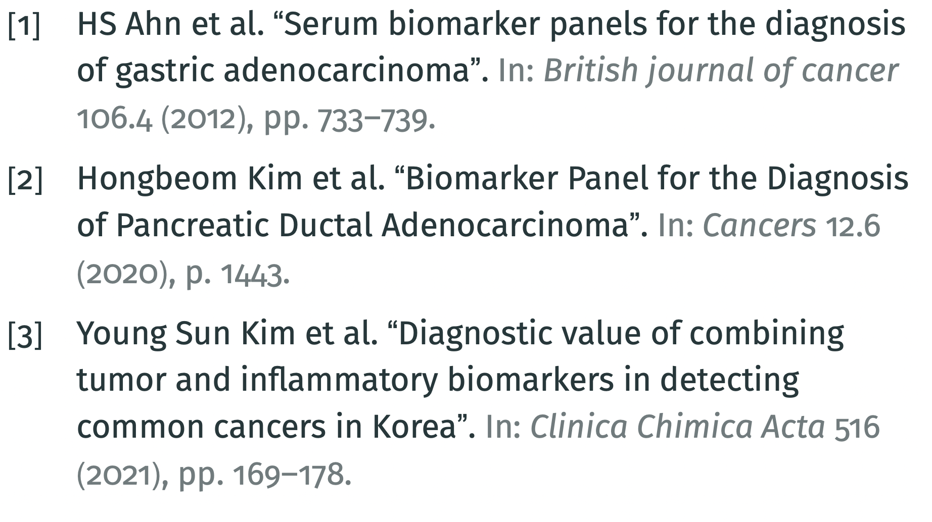
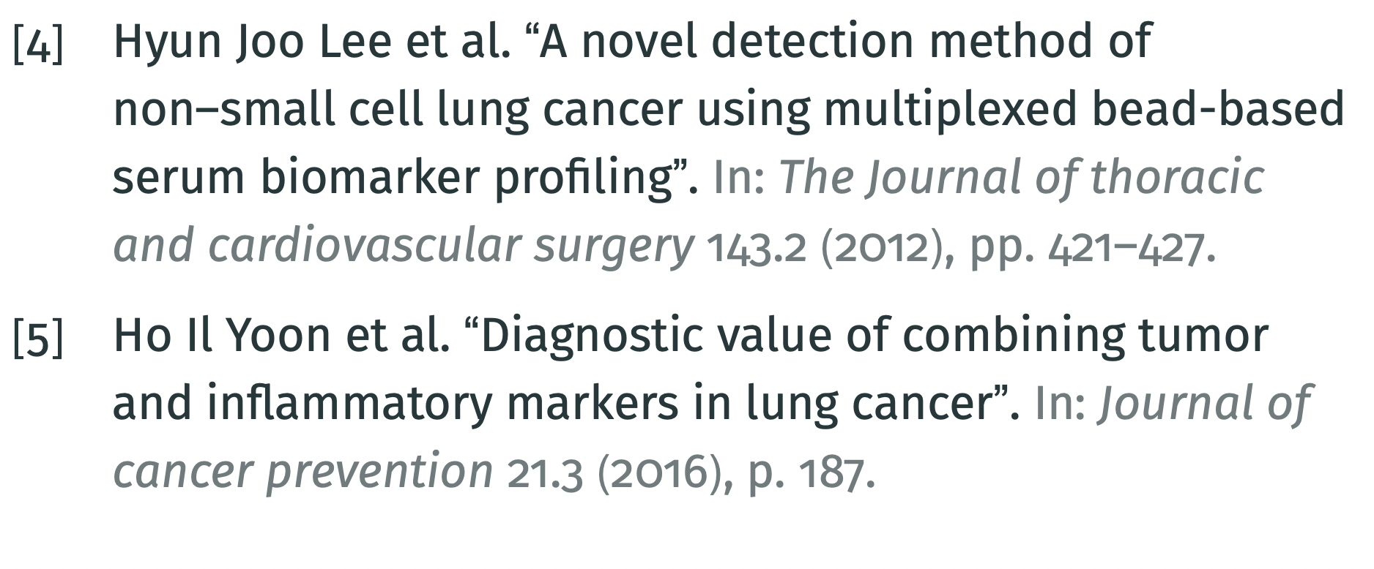
References
Notes:
심리학에서 나온 자극-반응의 이론을 토대로,

